Slide 1


1/10
Mudra Loans Analysis using Excel Dashboard
An Interactive Visualization & Analysis of Logistics Data
NAME OF PROJECT:
PRESENTED BY:
PRESENTED TO:
Mudra Loans Analysis
Gurveer Singh
Aashima Bansal

Slide 2


03 | Introduction
04 | Data Cleaning & Preprocessing
05 | Objectives
06 | Dashboard Overview
07 | Key Insights & Analysis
08 | Conclusion
09 | Acknowledgment
10 | References
Agenda

Slide 3

3/10
Introduction
This project analyzes data from the Mudra Loan Scheme using Microsoft Excel.
The dashboard provides insights into loan approvals, disbursements, defaults, job impact, and demographics.
Tools like PivotTables, slicers, and conditional formatting were used to create a fully interactive dashboard.

Slide 4

Data Preprocessing
05/10
To ensure the Mudra Loan dataset was clean and ready for meaningful analysis, the following preprocessing steps were carried out:
Removed Duplicate Entries: Verified and eliminated any repeated loan records to maintain data integrity and avoid inflating metrics.
Handled Missing and Error Values: Reviewed and cleaned blank or inconsistent entries in crucial fields such as Loan Approved, Loan Disbursed, and State names.
Formatted Columns and Data Types: Standardized columns like Loan Amounts, Default Counts, and Job Numbers to ensure proper numeric formatting for calculations and visualization.
Converted Raw Data into Table Format: Structured key sheets (Loan Trends, Defaults, Jobs, etc.) using Excel's Table feature to enable efficient filtering, referencing, and dashboard linkage.
Created New Calculated Fields: Derived important metrics such as Total Jobs Impact (Created + Retained), Default Rates per State, and Loan Efficiency Ratios for enhanced analysis.

Slide 5


Project Objectives
07/10
The main objectives of this Excel dashboard project were:
Goal # 1
Goal # 2
Track loan disbursement and approval trends over time
Identify state-wise loan performance
Goal # 3
Goal # 4
Goal # 5
Evaluate loan defaults by state
Assess impact on job creation and retention
Analyze loans by demographics: category, region, gender

Slide 6
Dashboard Overview
6/10
This dashboard was created using Microsoft Excel and is designed to provide a clear and interactive view of Mudra Loan data across states and years. It visualizes key financial and socio-economic insights from the scheme to support data-driven decision-making.
🔑 Key Features:
💰 Loan Trends Over Time: Visualizes the yearly progression of loan approvals and disbursements, helping track policy impact.
📍 State-Wise Loan Distribution: Highlights states with the highest and lowest disbursement and approval volumes.
⚠️ Default Analysis: Shows default counts by state, assisting in identifying high-risk regions.
👥 Job Impact Metrics: Displays the number of jobs created and retained under the scheme across states.
🌐 Demographic Breakdown: Analyzes loans by demographic segments such as rural/urban, gender, and borrower categories (e.g., SC/ST/OBC).

Slide 7
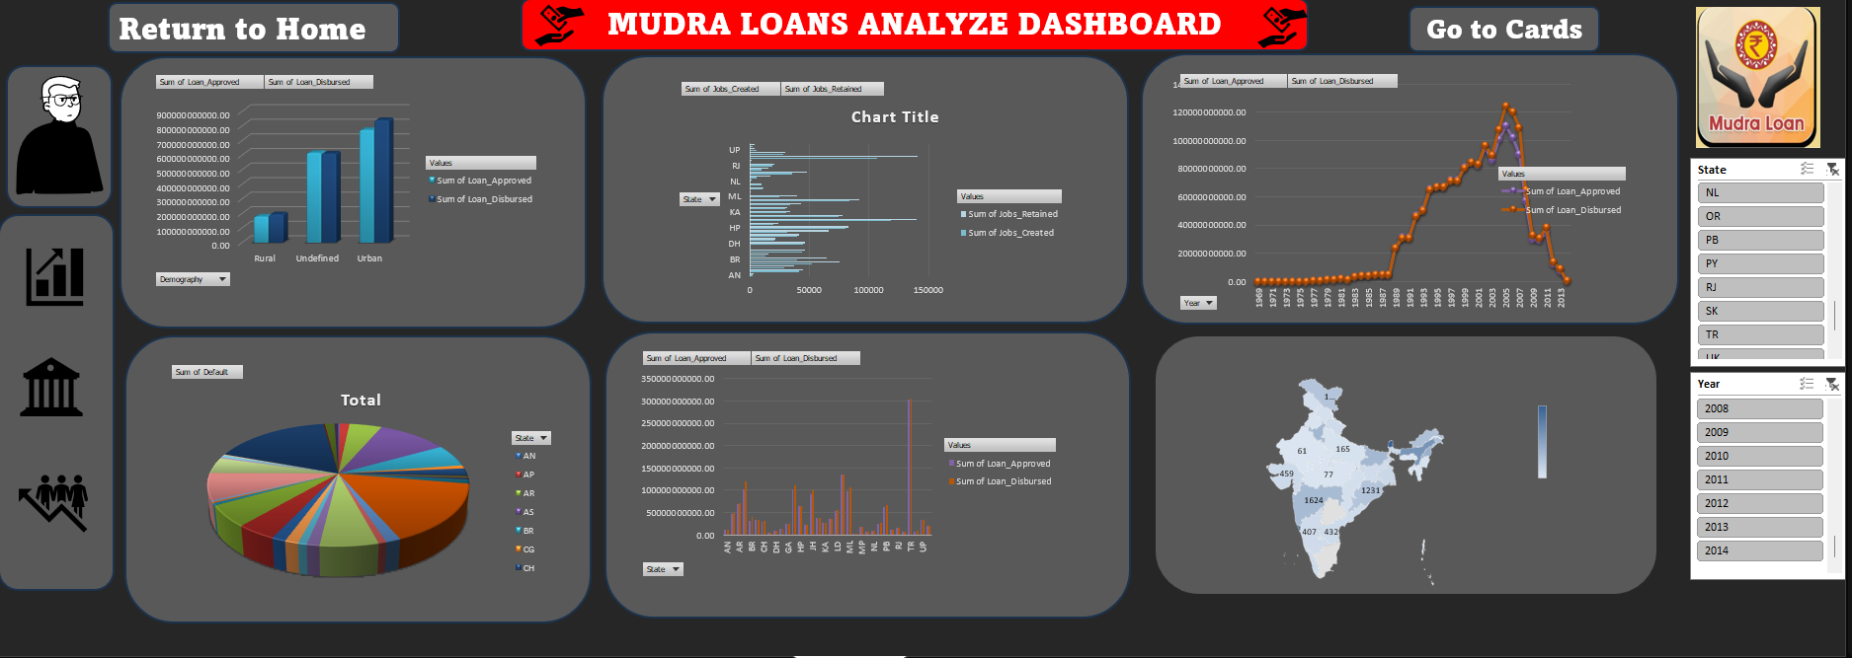

Slide 8

04/10
Dataset Source
The dataset used in this project is based on data from the Pradhan Mantri Mudra Yojana (PMMY), an initiative by the Government of India to support micro and small enterprises. The data was compiled into an Excel dashboard for analysis and visualization.
The dataset includes the following key information:
🏦 Loan Amounts (Approved & Disbursed):Financial details of loans approved and disbursed under the scheme, crucial for funding analysis.
🗺️ State-Wise Distribution: Breakdown of loan data across various states and union territories.
⚠️ Loan Defaults: Counts of defaulted loans by state, important for risk assessment.
👷 Jobs Created & Retained: Employment impact data to evaluate the socio-economic effect of the scheme.
📊 Demographic Segments: Categorical data showing disbursement trends across borrower types (e.g., SC, ST, OBC), gender, and rural/urban classification.

Slide 9

Insights and Findings
09/10
The interactive dashboard helped uncover key insights from the Mudra Loan dataset, revealing patterns in disbursement, defaults, and socio-economic impact:
Loan Disbursement Trends: There has been a steady increase in both loan approvals and disbursements over the years, indicating growing adoption and support for micro and small enterprises.
State-Wise Performance: Certain states (like Maharashtra, Tamil Nadu, and Uttar Pradesh) consistently show higher disbursement volumes, highlighting regional economic activity and program outreach.
Loan Defaults: Some states recorded significantly higher default counts, suggesting potential areas for policy revision or improved loan monitoring.
Job Creation and Retention: The scheme has had a measurable employment impact, with thousands of jobs created and retained across various states, contributing to local economic development.
Demographic Insights: A large portion of loans were availed by borrowers in rural areas, and notable participation was seen from women and marginalized communities (SC/ST/OBC), supporting the program’s inclusivity goals.

Slide 10


References
10/10
Internal Data Source:
Mudra Loans dataset provided by my brother, who is currently working at Mudra Loans, for academic and analytical purposes.
Microsoft Excel Documentation
Excel Functions and Features
Source: https://support.microsoft.com
Data Visualization Concepts
Best Practices for Creating Dashboards
Source: Microsoft Learn and Official Excel Blog
Academic Guidance
Special thanks to Aashima Bansal, for her valuable knowledge, support, and guidance throughout the project.

Slide 11
Thank you

